Slide 1
AIR QUALITY ANALYSIS AND PREDICTION IN TAMILNADU.
PHASE 3 : DEVELOPMENT PART 1
TOPIC: BUILDING THE AIR QUALITY ANALYSIS AND PREDICTION BY LOADING AND PREPROCESSING THE DATASET.

Slide 2
INTRODUCTION
The economic and social impact of poor air quality in towns and cities is increasingly being recognised, together with the need for effective ways of creating awareness of realtime air quality levels airand their impact on health.
Currently, computational intelligence approaches involve use of smart algorithms such as decision trees, neural networks, self-organizing maps, support vector machines etc. in predicting air quality. This method is advantageous because of its high accuracy and computational efficiency.

Slide 3
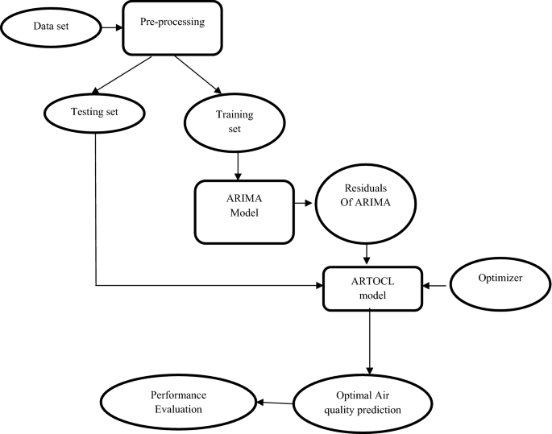
DIAGRAM:

Slide 4
PREPROCESSING DATASET:
Data Preprocessing:
Clean and preprocess the data to remove any inconsistencies, missing values, and outliers. You may need to handle date and time data, as well as convert categorical variables into numerical representations.
Data Exploration:
Perform exploratory data analysis (EDA) to understand the characteristics of the dataset. Visualizations and summary statistics can help you identify patterns and trends.
Feature Engineering:
Create relevant features that can be used in your air quality prediction model. This might include weather data, geographical coordinates, or historical air quality measurements.
Split the Data:
Split your dataset into training, validation, and testing sets. The training set is used to train your model, the validation set is used for tuning hyperparameters, and the testing set is used to evaluate the model's performance.

Slide 5
LOADING DATASET:
Data Collection:
Gather historical air quality data for Tamilnadu. You can obtain this data from government agencies, research institutions, or environmental monitoring stations.
Collect meteorological data such as temperature, humidity, wind speed, and wind direction, which can impact air quality.
Exploratory Data Analysis (EDA):
Visualize the data to identify trends, patterns, and correlations. EDA helps in understanding the data and identifying potential factors influencing air quality.
Feature Engineering:
Create relevant features based on domain knowledge. For example, consider lag variables, seasonal patterns, and interactions between variables.
Data Splitting:
Split the dataset into training, validation, and test sets to evaluate the performance of predictive models.

Slide 6
PREPROCESSING DATASET EXAMPLE:
# importing pandas module for data frame
import pandas as pd
# loading dataset and storing in train variable
train=pd.read_csv('AQI.csv')
# display top 5 data
train.head()

Slide 7
OUTPUT:
PM2.5 AVG PM10 AVG NO2 AVG NH3 AVG SO2 AG CO OZONE AVG air quality index
190 131 107 4 42 0 63 190
188 131 110 4 40 0 62 188
280 174 155 2 37 0 52 280
302 181 144 2 39 0 78 302

Slide 8
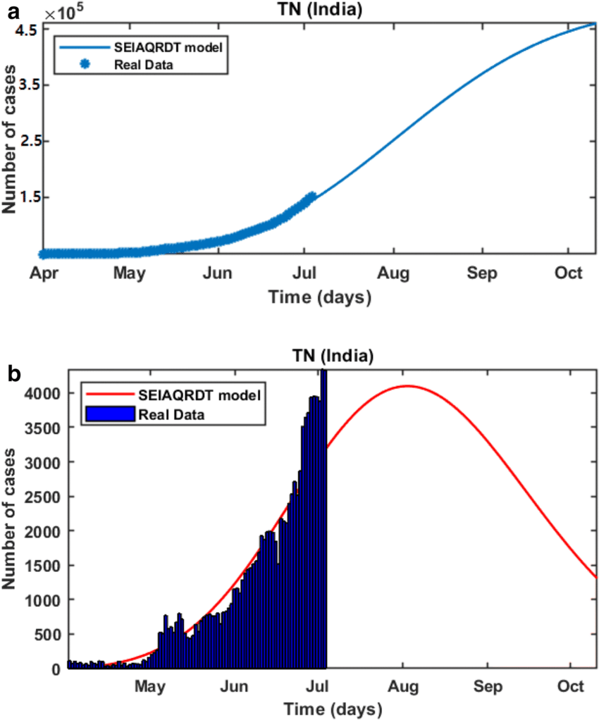
GRAPH:

Slide 9
THANKING YOU.

